Slide 1


GEMZZ: Empowering Gen Z's Financial Future
Introducing GEMZZ, an innovative startup dedicated to revolutionizing the way Gen Z engages with stocks and trading. By combining user-friendly UI/UX elements, GEMZZ aims to demystify the complex world of finance and empower the next generation to take control of their financial destiny.

Slide 2

Addressing the Gen Z Investing Gap
Accessibility
Education
Streamline the investment process with intuitive platforms and low barriers to entry, empowering Gen Z to confidently navigate the financial landscape.
Provide comprehensive educational resources and interactive tools to boost financial literacy and help Gen Z make informed investment decisions.
Relatability
Cultivate a user experience that resonates with Gen Z's preferences, incorporating social elements and a visually engaging design to foster engagement.

Slide 3
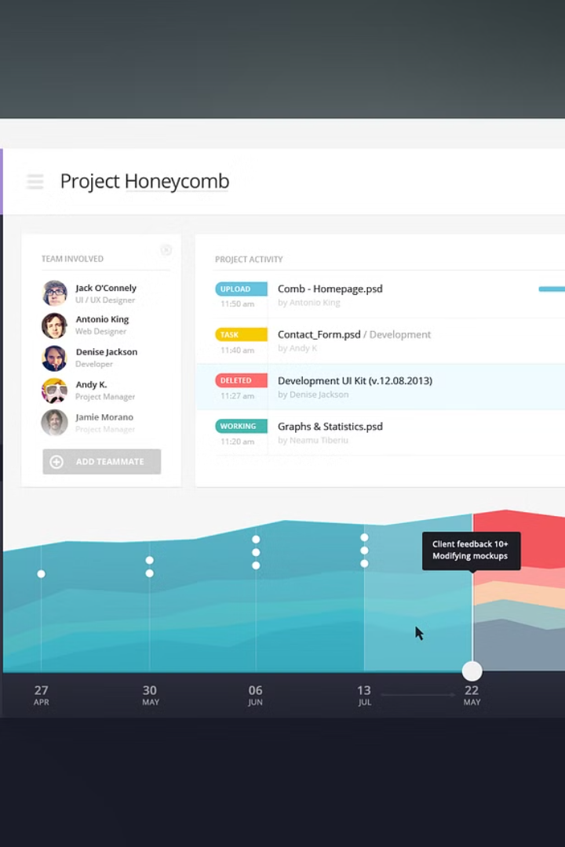
Intuitive UI/UX Design
GEMZZ features a visually appealing and highly intuitive user interface that is tailored to the preferences and expectations of Gen Z investors. The seamless design and smooth navigation ensure a user-friendly experience, empowering young investors to confidently manage their financial portfolios.
Leveraging the latest UI/UX best practices, GEMZZ's interface is optimized for mobile devices, providing Gen Z users with a responsive and accessible platform to stay connected to their investments on-the-go.

Slide 4
Educational Content and Resources
GEMZZ offers a comprehensive educational platform to empower Gen Z investors. From interactive tutorials on stock trading fundamentals to in-depth analysis of financial trends, our resources equip users with the knowledge they need to make informed investment decisions.
Beginner-friendly lessons on investing basics
Webinars and workshops led by industry experts
Personalized learning paths tailored to user goals

Slide 5




Social Trading Features
Social Feeds
Leaderboards
Copy Trading
Discussion Forums
Stay connected with a vibrant community of fellow investors. Share insights, strategies, and trade ideas in real-time.
Compete with your peers and track the performance of top traders. Gain inspiration and learn from the best in the industry.
Easily mirror the trades of experienced investors, allowing you to learn and grow your portfolio alongside proven strategies.
Engage in thought-provoking discussions, ask questions, and collaborate with a diverse community of finance enthusiasts.

Slide 6
Gamification and Rewards
Engaging Mini-Games
Leveling Up System
Embedded mini-games and challenges encourage users to stay active on the platform, learn about investing, and earn rewards.
Users can level up their accounts by completing tasks, earning badges, and unlocking new features as they progress.
Virtual Currency and Rewards
Social Leaderboards
Users can earn virtual currency and redeem rewards like free stock trades, access to premium content, or physical merchandise.
Friendly competition through social leaderboards motivates users to actively engage and excel on the platform.

Slide 7
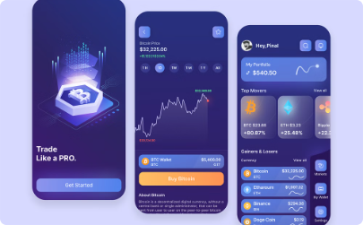

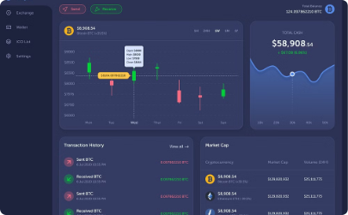
Cryptocurrency Integration
Seamless Integration
Secure Storage
Real-Time Market Insights
GEMZZ seamlessly integrates popular cryptocurrencies, enabling Gen Z investors to easily access and trade digital assets alongside traditional stocks and securities.
GEMZZ provides a built-in cryptocurrency wallet, allowing users to safely store their digital holdings and manage their entire investment portfolio in one convenient platform.
With real-time cryptocurrency market data and analysis, GEMZZ empowers Gen Z investors to make informed decisions and capitalize on emerging trends in the digital asset space.

Slide 8
Personalized Investment Recommendations
AI-Powered Analysis
Holistic Portfolio Optimization
Continuous Learning
Transparency and Control
GEMZZ leverages advanced artificial intelligence to analyze each user's risk tolerance, financial goals, and investment preferences. This enables personalized recommendations tailored to the individual's unique needs.
GEMZZ's recommendation engine continuously learns from user behavior and market trends to refine its suggestions, ensuring they remain relevant and beneficial over time.
Users maintain full transparency and control over their investments. GEMZZ's recommendations are accompanied by clear explanations, allowing users to make informed decisions.
The platform considers a user's entire investment portfolio to provide holistic recommendations that balance risk, diversification, and long-term growth potential.

Slide 9

Scalable and Secure Platform
1
Robust Infrastructure
GEMZZ is built on a scalable and highly available cloud-based infrastructure, ensuring seamless performance and reliability even as the user base grows.
2
Cutting-Edge Security
Rigorous security measures, including military-grade encryption, multi-factor authentication, and advanced fraud detection, safeguard your financial data and transactions.
3
Regulatory Compliance
GEMZZ adheres to all relevant financial regulations and industry best practices, giving you peace of mind and confidence in your investments.

Slide 10

The GEMZZ Advantage: Democratizing Investing
GEMZZ sets itself apart by democratizing investing, empowering Gen Z to take control of their financial futures. With its user-friendly platform and educational resources, GEMZZ makes navigating the complex world of stocks and trading accessible to all.
By bridging the gap between traditional finance and the digital-native Gen Z, GEMZZ paves the way for a more inclusive and equitable investment landscape. Its intuitive design and gamified features inspire confidence and engagement, fostering a new generation of informed and savvy investors.

